Slide 1
Statistical independence

Slide 2
Conditional and unconditional probabilities
Sample space
Pr({Red})
=4/12=1/3
With the condition of Event “B”
Pr({Red}|{Ball})
=2/8=1/4

Slide 3
Independent events: when unconditional and conditional probabilities are equal
If in a new experiment where we replace the two blue balls with two red balls…THEN
Pr(R)
= “6 red objects of a total of 12 objects”
= 0.5, and
Simple sample space (n=12)
Pr(R|B)
= “4 red balls out of a total of 8 balls”
=0.5
Now, {B} does not affect the probability of {R}. We call them independent events. PS: verify that Pr(B)=Pr(B|R)

Slide 4
Example
Suppose 10% of NBS students are international students, and the event of {an intl student} is independent to {an NBS student}. Now we randomly select a NTU student.
Pr({an intl student}|{an NBS student})=?
Pr({an intl student})=?
Pr({a local student})=?
Pr({a local student}|{an NBS student})=?
Pr({a local student}|{not an NBS student})=?

Slide 5
Example
Suppose 10% of NBS students are international students, and the event of {an intl student} is independent to {an NBS student}. Now we randomly select a NTU student.
Pr({an intl student}|{an NBS student})=?
Pr({an intl student})=?
Pr({a local student})=?
Pr({a local student}|{an NBS student})=?
Pr({a local student}|{not an NBS student})=?

Slide 6

Independent events
Two events are independent events when their conditional probabilities are equal to their unconditional probabilities
Observe: Independence is a two-way relationship
When A is independent to B, it implies A & “not A” are also independent to B and “not B.”
$Pr\left(A | B\right)=$ $\operatorname{Pr}\left(A\right)$ (A is independent to B)
or equivalently
$Pr\left(B | A\right)=\operatorname{Pr}\left(B\right)$ (B is independent to A)

Slide 7
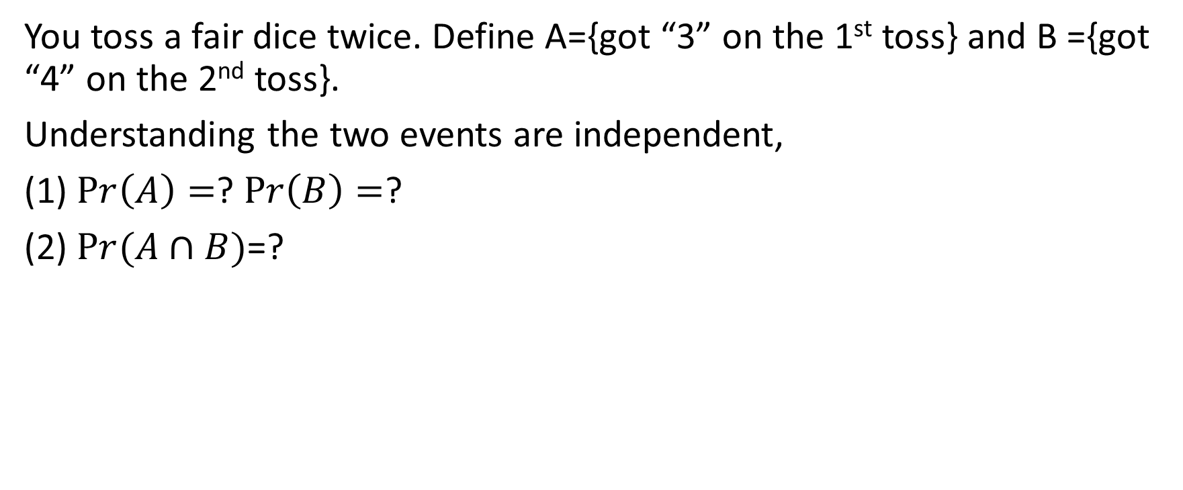
Example : Independent events
You toss a fair dice twice. Define A={got “3” on the 1st toss} and B ={got “4” on the 2nd toss}.
Understanding the two events are independent,
(1) $Pr\left(A\right)=$? $Pr\left(B\right)=$?
(2) $Pr(A∩B)$=?

